Slide 1

REVIEW RATINGS
PREDICTION
INTERNSHIP – 30
IBRAHIM ABDUL SHUKOOR
SME : MOHD KASHIF

Slide 2
INDEX
INTRODUCTION
DATA SCRAPING
DATA PREPROCESSING
EDA & VISUALIZATIONS
MODEL SELECTION
SUMMARY

Slide 3
INTRODUCTION
A customer has a website where users can post various product reviews for technical items. They're including a new function onto their website called. The reviewer must also include their rating in the form of stars. There are only 5 alternatives available, and the ranking is out of 5. 1, 2, 3, 4, and 5 stars, respectively. They are attempting to forecast ratings for past reviews that have not yet received one. Therefore, we must create a program that can gauge the rating from the review.

Slide 4
DATA SCRAPING
Reviews were scraped from product pages of Laptops, Smart Watches, Printers, Monitors, Home theatres and Cameras. The websites these products were searched in are Amazon and Flipkart. In total 47,000 reviews were scraped.

Slide 5
DATA PREPROCESSING
The following actions were taken during the data pre-processing:
The “Ratings” column was cleaned.
Created columns to contain words and characters present in the review column. Further cleaning was done:
a. Emails were replaced with “email”
b. Websites were replaced with “website”
c. Currencies were replaced with “currency”
d. Phone numbers were replaced with “phonenumber”
e. Cleaned additional things such as trailing, leading white spaces,
removed stop words.

Slide 6
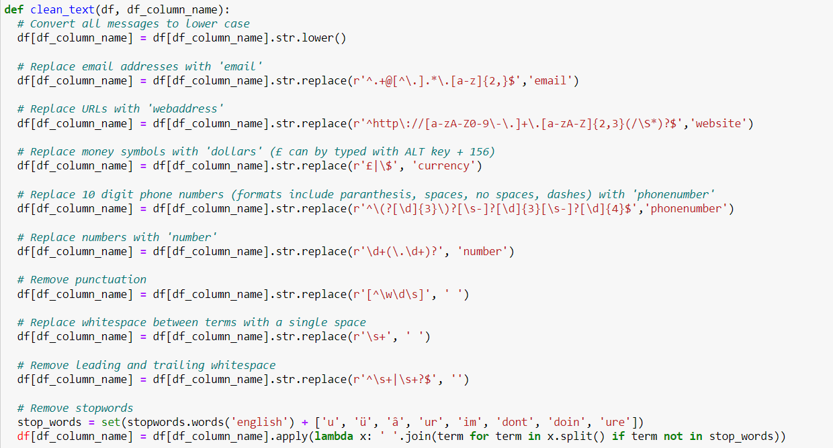
DATA PREPROCESSING
Fig 1: snippet of the comment cleaning code

Slide 7
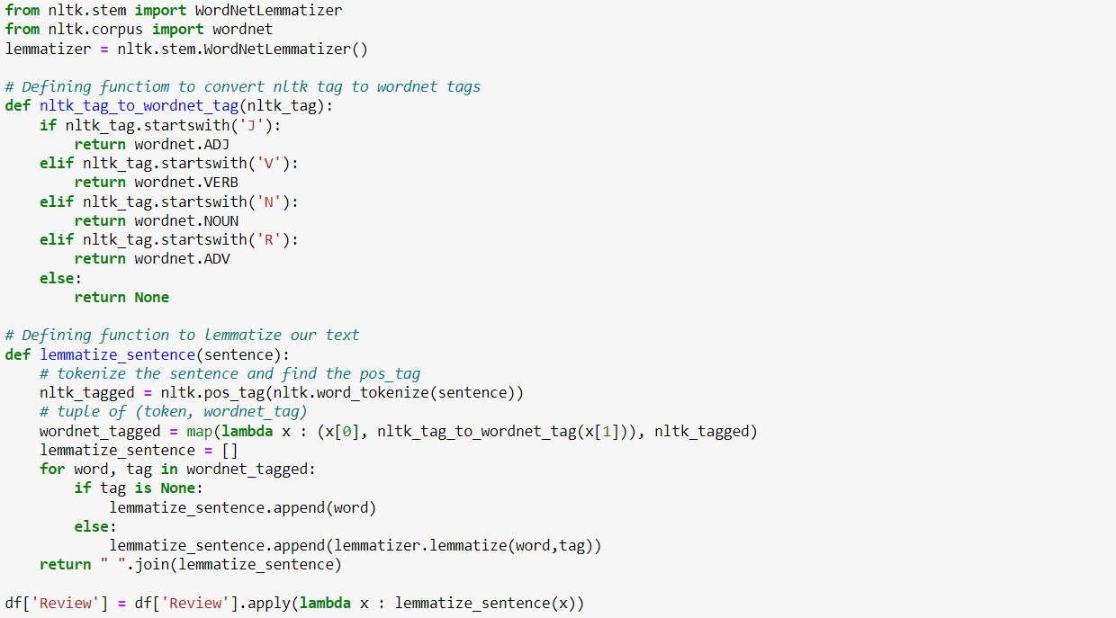
DATA PREPROCESSING
Fig 2: snippet of the comment lemmatizing code

Slide 8
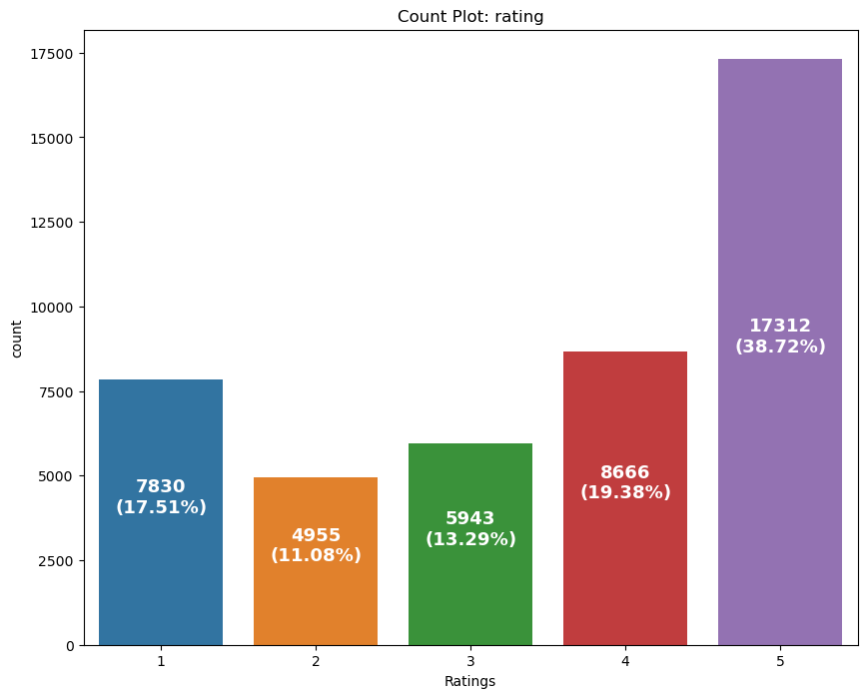
EDA & VISUALIZATION
Fig 3: count-plot of the words present with respect to rating column

Slide 9
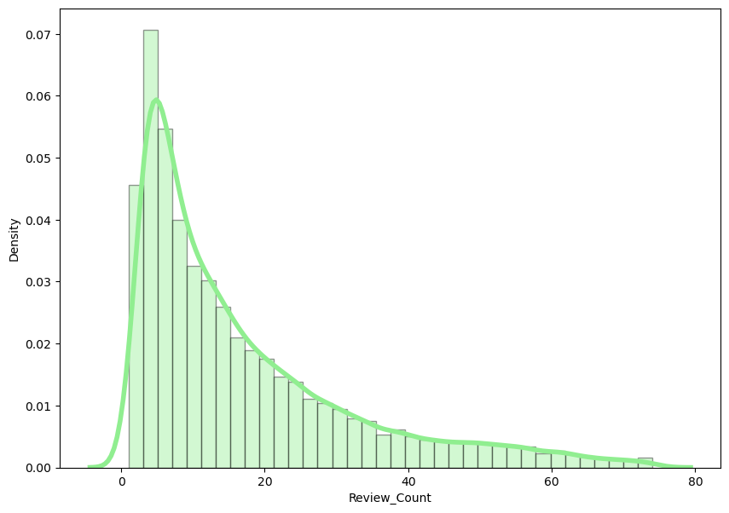
EDA & VISUALIZATION
Fig 4: distribution-plot of the word count

Slide 10
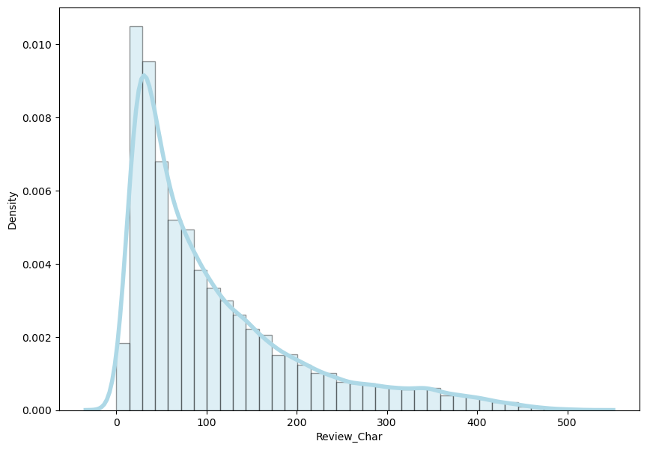
EDA & VISUALIZATION
Fig 5: distribution-plot of the character count

Slide 11
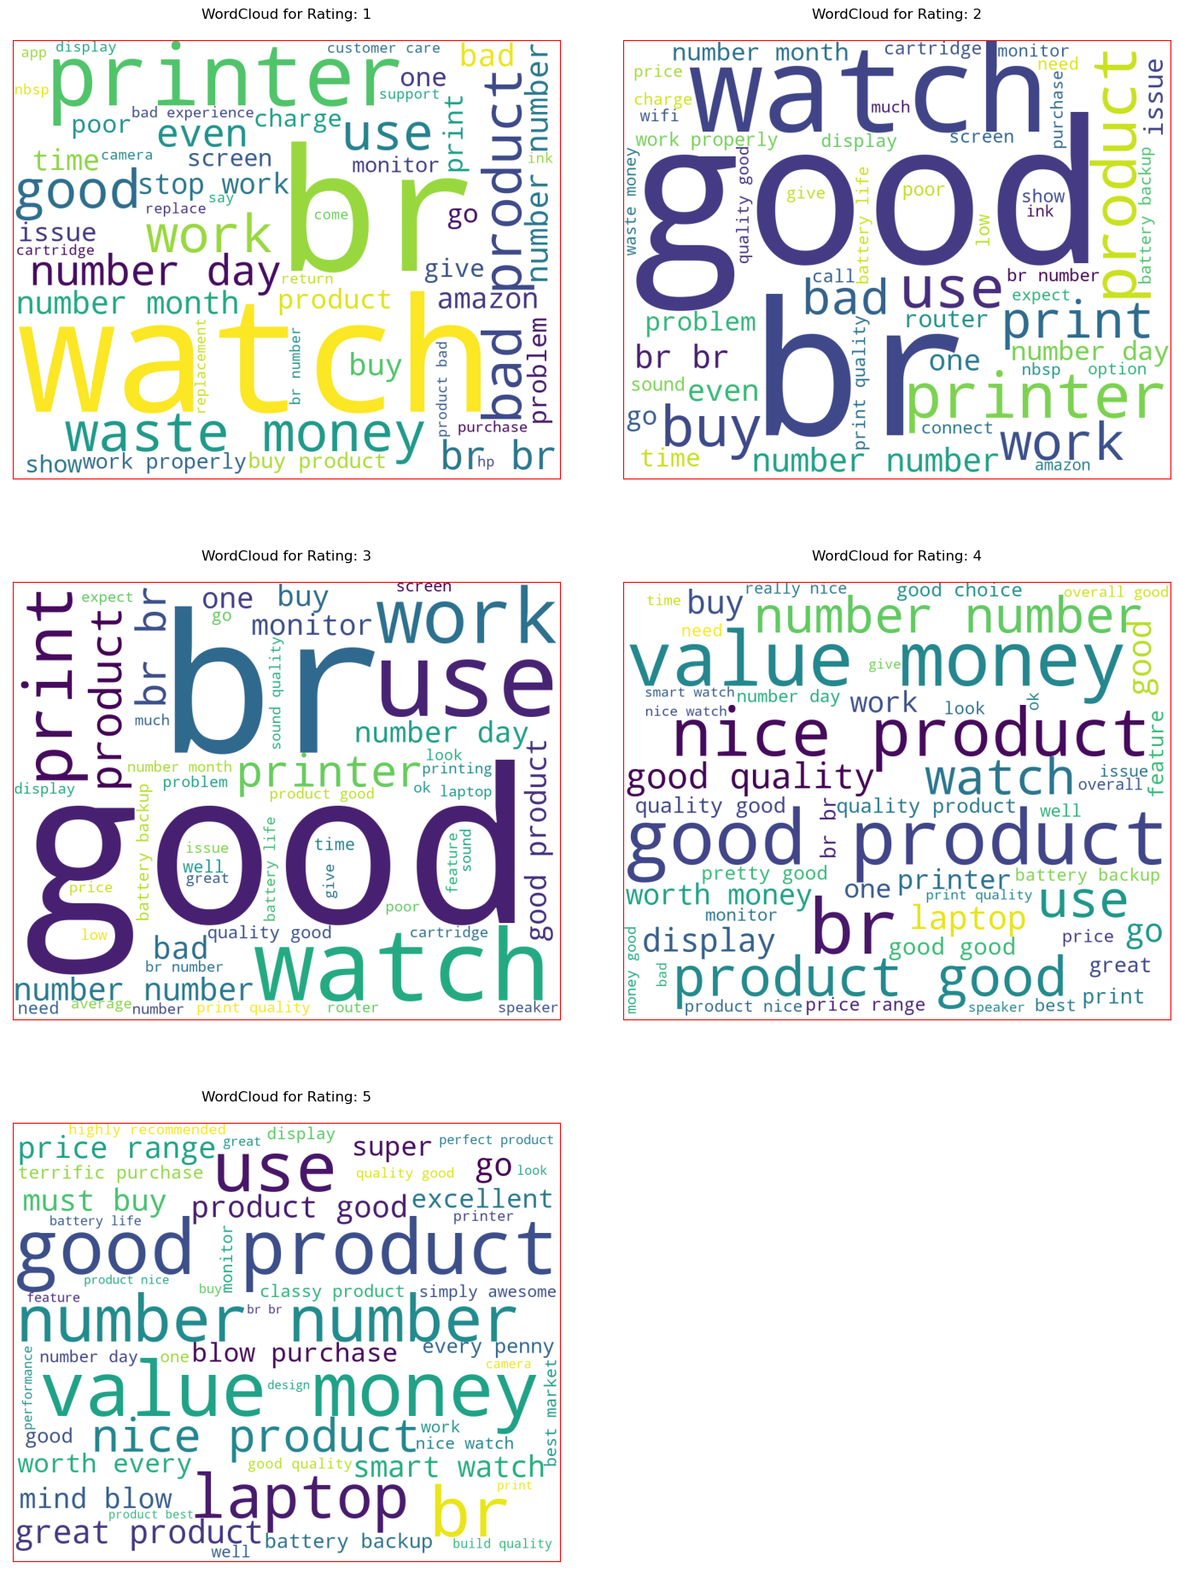
EDA & VISUALIZATION
Fig 6: word cloud with respect to rating

Slide 12
MODEL SELECTION
6 machine learning models were tested 1 model was selected based on the performance metrics (Accuracy, F1 Score and Confusion matrix).
Logistic Regression
Linear SVC (BEST MODEL)
Bernoulli Naive Bayes
Multinomial Naive Bayes
SGD Classifier
LGBM Classifier

Slide 13
SUMMARY
The best accuracy for our machine learning model is 78%. Various observations have been made with respect to ratings and the word counts. A superior method of data cleaning could be implemented to enhance the model performance and accuracy.

